Slide 1
Evaluation of factoid answers
Presented By:
Aashish Gyanwali (078MSIISE-1)
Bishal Maharjan (078MSIISE-3)
Nabin Upreti (078MSIISE-11)

Slide 2
OUTLINE
INTRODUCTION
EVALUATING QA SYSTEMS
REASONS FOR CAUTION
STRICT AND LENIENT MEASURES
POTENTIAL SOLUTIONS
CONCLUSION

Slide 3
INTRODUCTION
Question Answering (QA) is a fast-growing research area that brings together research from Information Retrieval, Information Extraction and Natural Language Processing.
The use of test collections to assess the performance of information retrieval systems is a well-established methodology.
Test collections enable the effectiveness of different retrieval methods to be compared without human involvement to assess the relevance of the returned documents.

Slide 4
INTRODUCTION
Large test collections for the so called ad hoc task have been created by pooling the ranked lists returned by participants in large-scale.
With pooling, the top n documents (the pool depth) from each run are gathered, and after removing duplicates, are presented to human assessors for evaluation.
The pooling methodology creates trustworthy and reliable resources for post-hoc experimentation.

Slide 5
EVALUATING QA SYSTEMS
In the TREC instantiation of the question answering task, a system response to a natural language question is a pair consisting of an answer string and a supporting
To this response unit, a human assessor assigns one of four labels: correct, inexact, unsupported, or wrong.
Correct:-the answer string must contain exactly the information requested by the question and the supporting document must present the answer in a manner such that a human reading the document could verify its correctness.
Inexact:-If the answer string contains extraneous words

Slide 6
EVALUATING QA SYSTEMS
unsupported:-If the answer string is correct (i.e., exact), but the document does not clearly answer the question
wrong:the response unit is wrong
In a typical QA track at TREC, participating systems are given four to five hundred factoid questions and are allowed to return one response per question.
Performance is measured by answer accuracy

Slide 7
EVALUATING QA SYSTEMS
Because judgments are made with respect to both an answer string and a particular document
Identical answer strings may be correct or unsupported, depending on the specific document from which that string came.
Small changes in the answer string might affect the judgment value,
there is no algorithmic way to determine whether a change between a judged string and a string to be evaluated is significant or not.
Thus, human assessors are needed to deal with intricacies such as exactness, answer granularity, and acceptability of variants.

Slide 8
EVALUATING QA SYSTEMS
Typically, two measures of answer accuracy, strict and lenient, are presented.
strict measure:-a response is considered correct only if the answer string matches the answer patterns and its supporting document is among those marked as relevant.
Lenient measure:-the supporting document is ignored, and response units are scored only on the answer strings

Slide 9
EVALUATING QA SYSTEMS
It is well-known that the automatically-generated strict measure underestimates answer accuracy because document level relevance judgments are incomplete
On the other hand, the lenient measure overestimates performance because documents often coincidentally contain the correct answer string without actually answering the question.
However, it is implicitly assumed that the combination of the two different evaluation criteria would closely approximate true question answering effectiveness.
However, no one to date has rigorously verified this assumption, and indeed, this study will reveal that TREC answer patterns and reldocs lists are not suitable for post-hoc experimentation

Slide 10
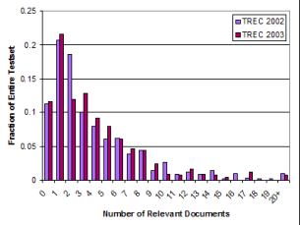
REASONS FOR CAUTION
Zobel demonstrated that a pool depth of one hundred documents produces a fair ranking of systems, he started noticing adverse effects on system rankings when the pool size was reduced below fifty documents.

Slide 11
REASONS FOR CAUTION
Two reasons for the soundness of the pooling strategy in ad hoc retrieval are that participants contributing to the pool employ
a relatively diverse set of strategies
that they achieve reasonable performance.
In the most recent QA track at TREC 2004, Ellen Voorhees reported in her overview talk that the median score for 92.2% of factoid questions was zero.
Since a human manually extracted answers for each question from the document collection, the run should achieve an accuracy of 1.0 when automatically evaluated with existing resources.

Slide 12
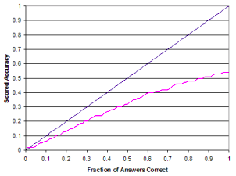
REASONS FOR CAUTION
This, unfortunately, is not the case generated run achieved a strict accuracy of only 0.53 using current evaluation resources.
With an “ideal” set of judgments, this graph should be a straight line with a slope of one through the origin, as shown by the reference line.

Slide 13
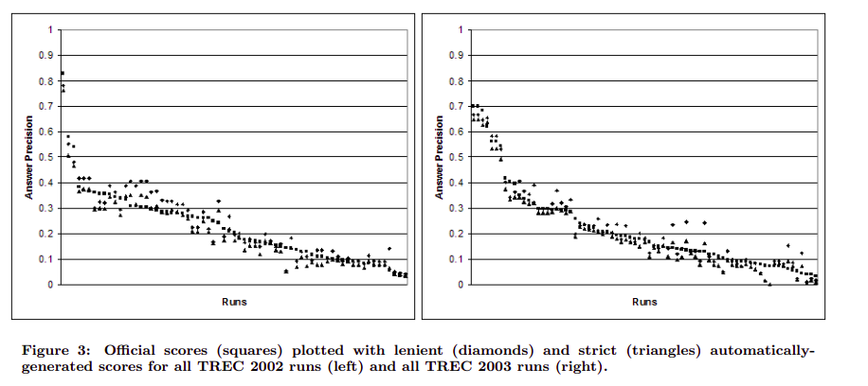
STRICT AND LENIENT MEASURES
For the 500 factoid questions in the TREC 2002 testset, the Kendall’s τ correlation between the official system rankings and the system rankings produced using the automatically-generated strict measure is 0.820; for the lenient measure, the correlation is 0.817.

Slide 14
STRICT AND LENIENT MEASURES
Results highlight the difficulty in crafting a good set of answer patterns and the problems associated with treating answers and supporting documents independently.
Question: Who was the first black heavyweight champion?
Answer: Jack Johnson
Supporting document: Louis was the first African-American heavyweight since Jack Johnson who was allowed to get close to that symbol of ultimate manhood, the heavyweight crown. . .
Although Jack Johnson was indeed the first black heavyweight champion, the document does not support the answer, i.e., it does not state that he was the first one. Thus, the above response would be marked unsupported.

Slide 15
STRICT AND LENIENT MEASURES
The lenient measure greatly overestimates answer accuracy when considering support.
Thus, for certain classes of question answering techniques, the discrepancy between official and lenient scores can be quite large.
The lenient measure is also a poor indicator of performance if one views question answering as an extension of finer-grained document retrieval techniques
Under such a view, the importance of the supporting document is undeniable.

Slide 16
POTENTIAL SOLUTIONS
Given the important role that reproducible, accurate, and reliable laboratory experiments play in information retrieval
How can we address the current lack of a truly reusable test collection for question answering?
One solution that has been suggested is to simply increase the pool depth to a point where a good set of judgments can be gathered.
This pooling approach, has the downside that it essentially adds a completely separate ad hoc retrieval component to the already difficult-to-evaluate question answering task.

Slide 17
CONCLUSION
one must be cautious when employing existing resources to evaluate question answering systems
they should not be used to make quantitative comparisons regarding the effectiveness of different techniques.
The errors associated with scores derived from answer patterns and reldocs lists prevent reliable conclusions from being drawn.
This meta-evaluation of question answering points out shortcomings in existing evaluation methodology as it relates to building reusable test collections for post-hoc experimentation

Slide 18
References
M. Wang, ‘A Survey of Answer Extraction Techniques in Factoid Question Answering’, Association for Computational Linguistics, 2006
Jimmy Lin, ‘Evaluation of Resources for Question Answering Evaluation’, International Conference on Research and Development in Information Retrieval (SIGIR), 2005

Slide 19
Thank You

